Slide 1
MassMutual DSDP / DEDP 2020: Visualization Techniques
July 7, 2020
R. Jordan Crouser
Assistant Professor of Computer Science
Smith College

Slide 2
Recall: deconstructing graphics
Find a data visualization you think is interesting
Some ideas: NYTimes, VisualisingData.com, Visual.ly
Remember to cite your source!
Identify the following:
What is the data that’s being visualized? Where did it come from?
Which data dimensions are mapped to which visual dimensions?
How does this shape your understanding of the data?
If you liked the visualization: what is it doing well?
If you disliked the visualization: what would you change?

Slide 3

Discussion
What makes a good encoding?

Slide 4
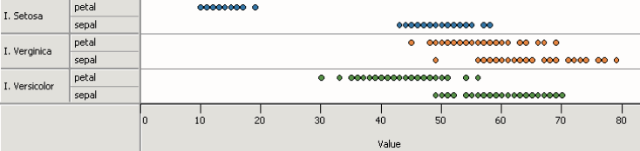
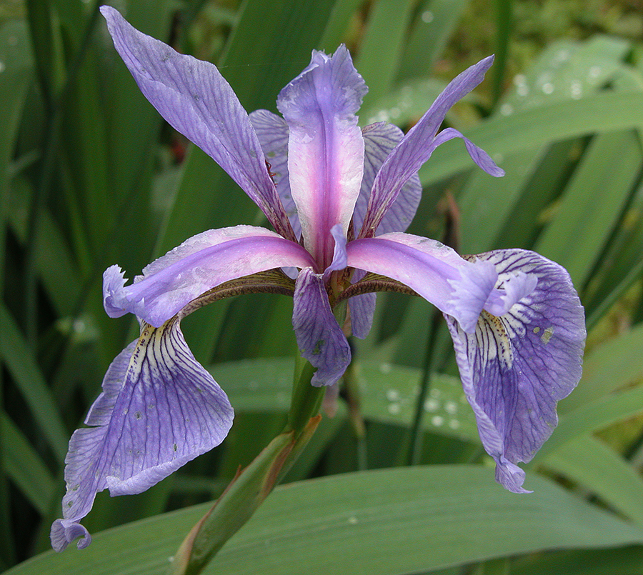

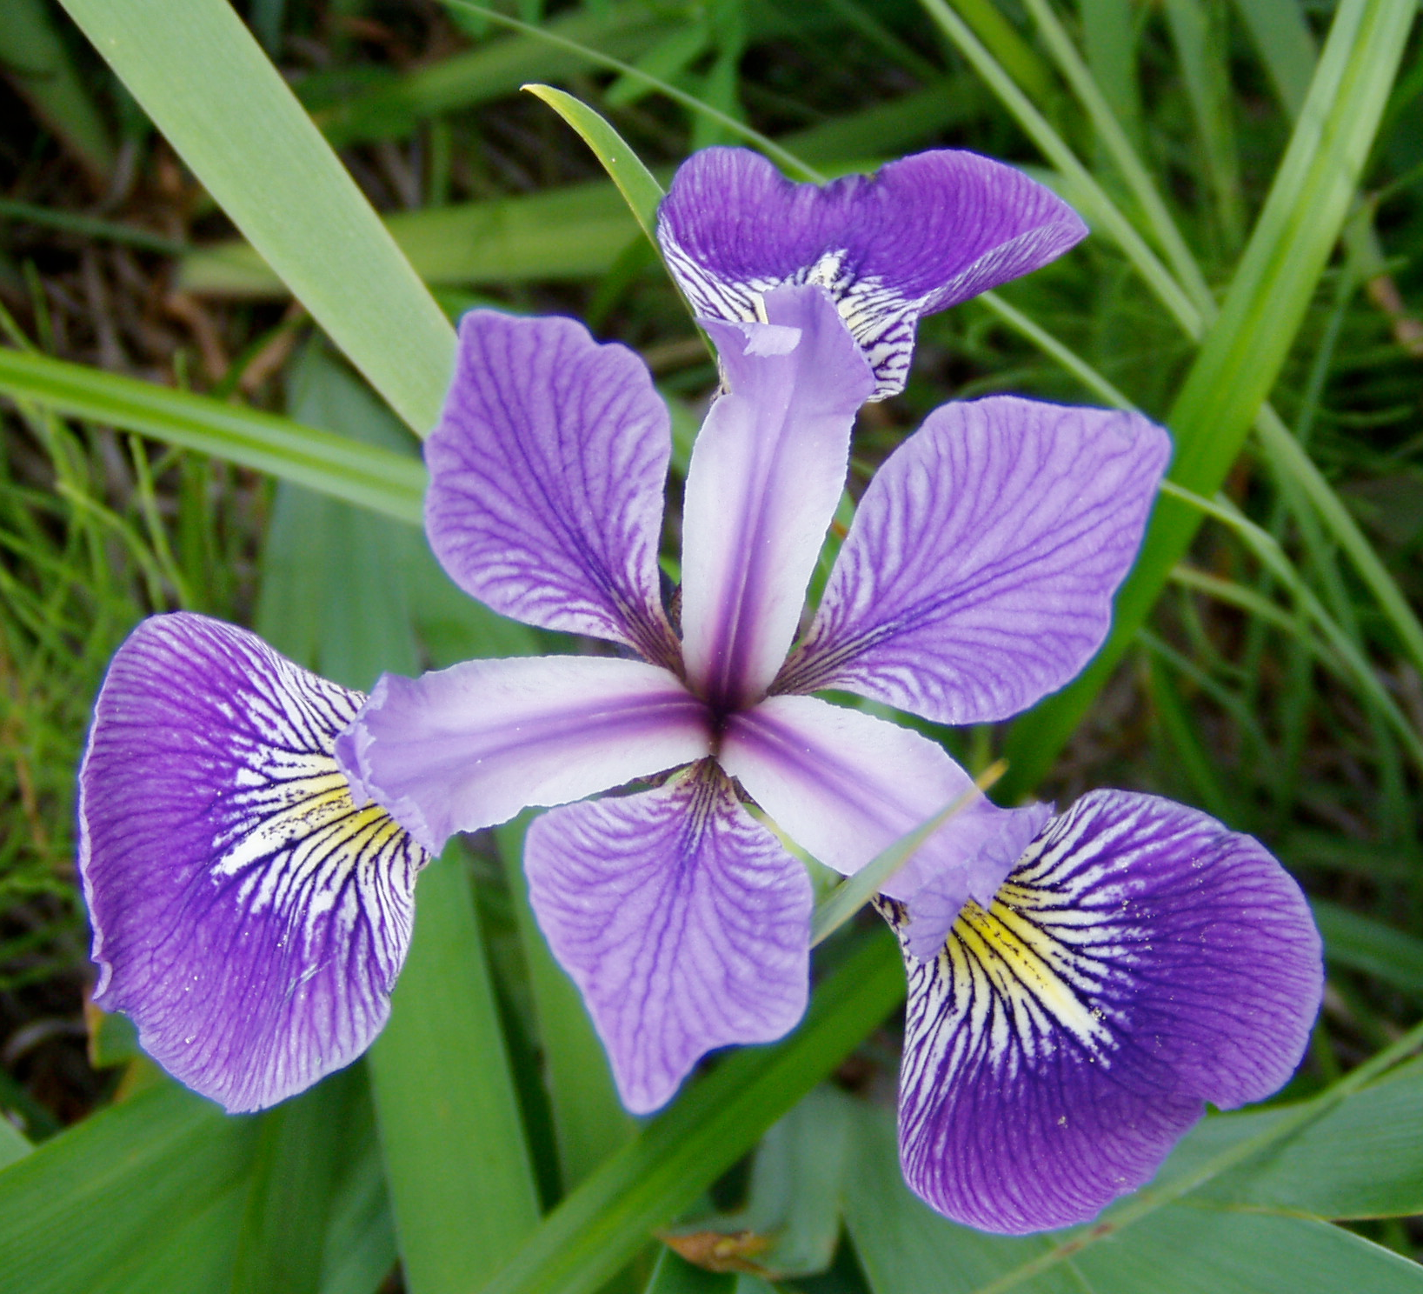
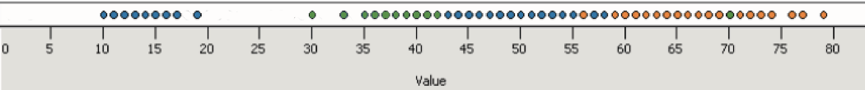
Principle 1: expressiveness
Encodes all the facts
Example:
Fig. Courtesy of M Krzywinski

Slide 5
Principle 1: expressiveness
Encodes only the facts
Example:
Adapted from Mackinlay J (1986) Automating the design of graphical presentations of relational information.

Slide 6
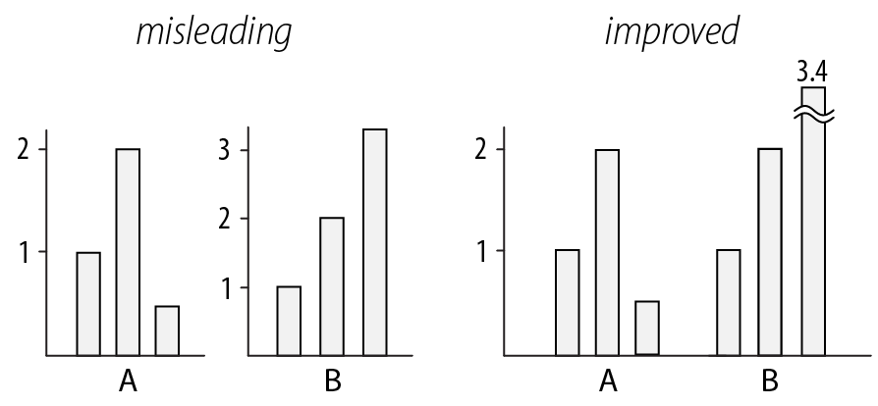
Principle 2: consistency
Use consistent axes when comparing charts
Raina SZ, et al. (2005) Evolution of base-substitution gradients
in primate mitochondrial genomes. Genome Res 15: 665-673.
M. Krzwinski, behind every great visualization is a design
principle, 2012

Slide 7
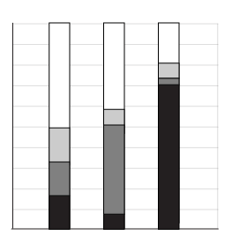
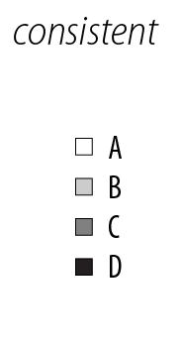
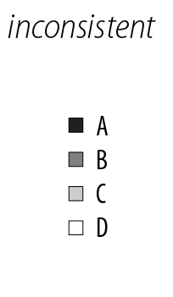
Principle 2: consistency
A note on legends: order items according to appearance
M. Krzwinski, behind every great visualization is a design principle, 2012

Slide 8
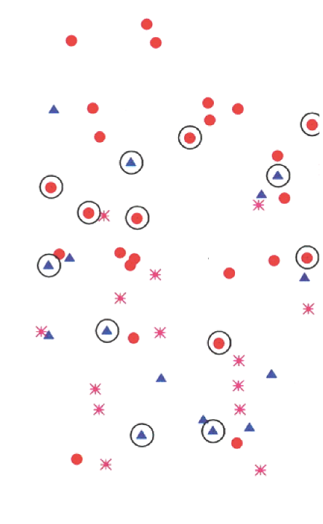
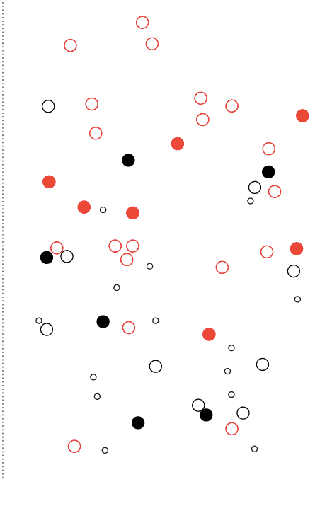
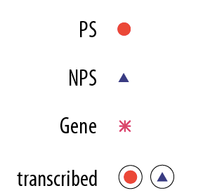
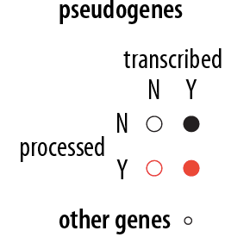
Principle 2: consistency
Visual variation should reflect and enhance the underlying variation in the data
Avoid visually similar encodings for independent variables
Example:

Slide 9
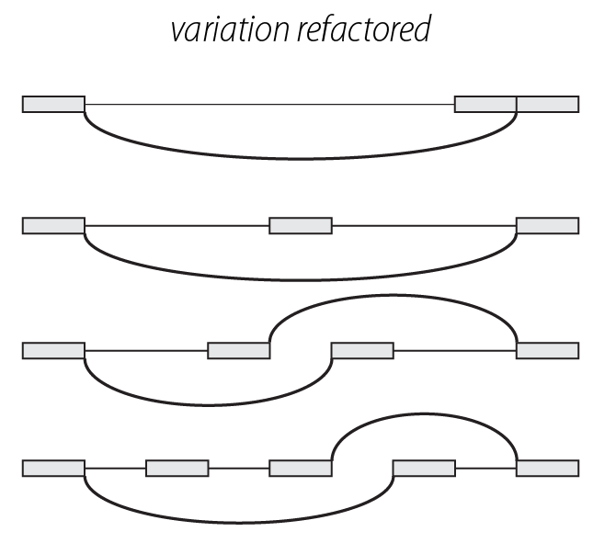
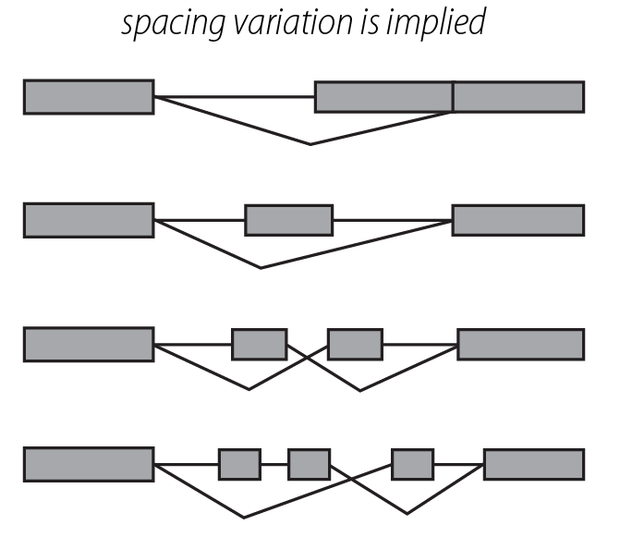
Principle 2: consistency
Uniform size and alignment reduces visual complexity and aids interpretation
Example:
Fig. 1: Sharov AA et al. (2005) Genome-wide assembly and analysis of alternative transcripts in mouse. Genome Res 15: 748-754.
Fig. 2: M. Krzwinski, behind every great visualization is a design principle, 2012

Slide 10
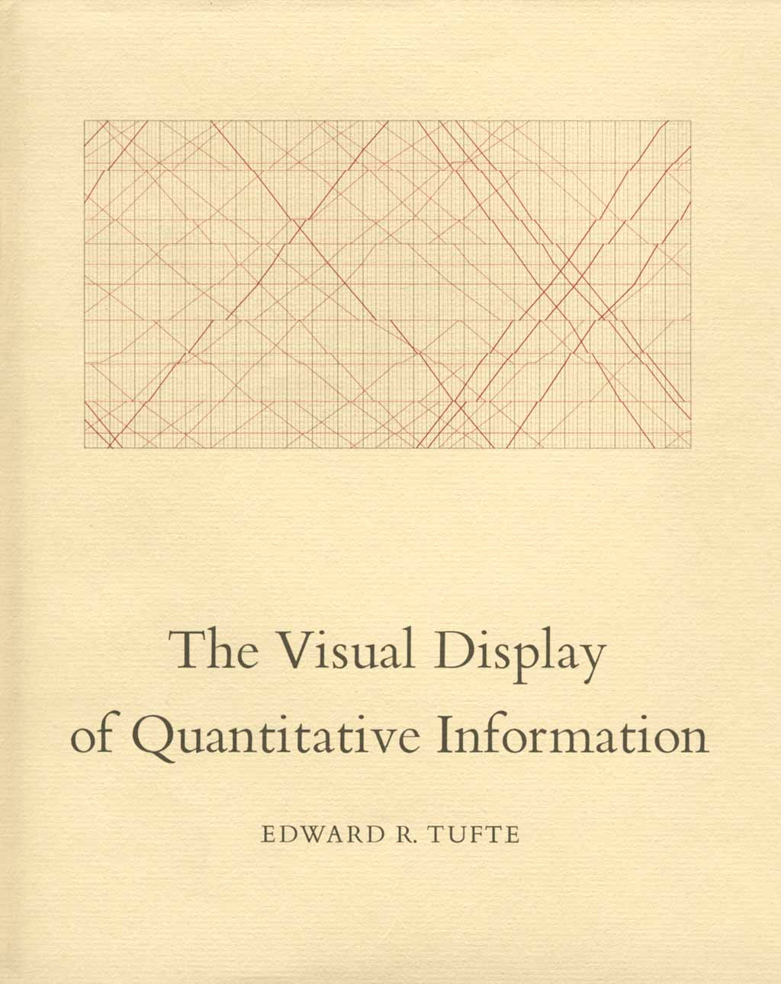
Tufte, 1983
“Above all else, show the data.”

Slide 11
Tufte, 1983

Slide 12
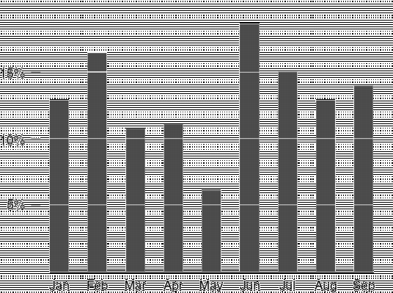
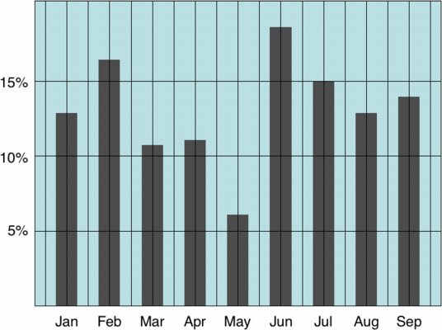
Tufte: maximize the data-ink ratio

Slide 13
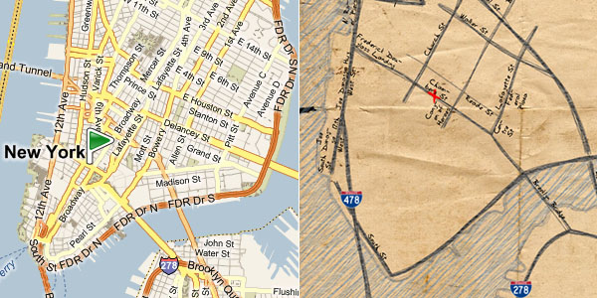
Familiar example

Slide 14
Discussion
What do you think of the data-ink ratio?
Consider ways to maximize it…

Slide 15
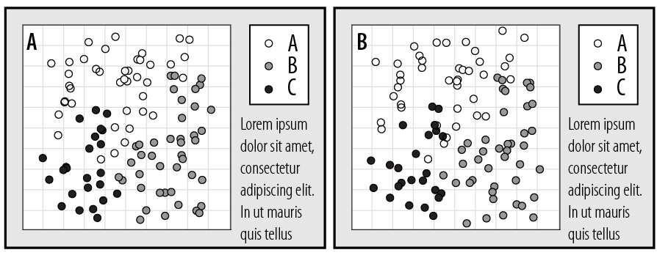
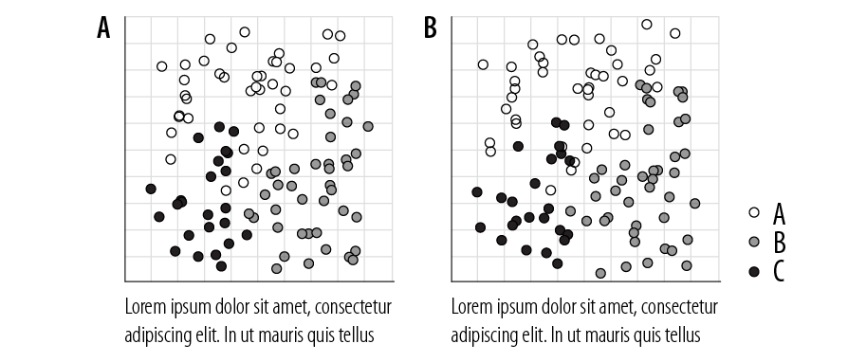
Principle 3: importance ordering
Avoid unnecessary containment and repetition
Example

Slide 16
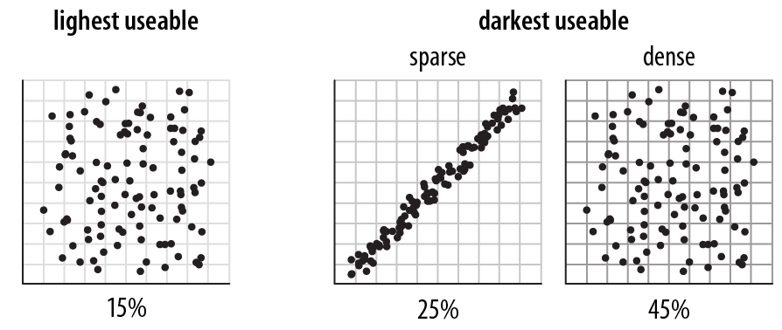
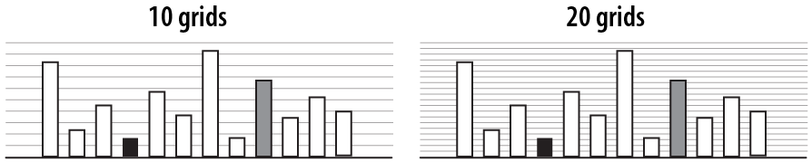
Principle 3: importance ordering
Navigational aids shouldn’t compete with data
Avoid: heavy axes, error bars and glyphs
Heer J, Bostock M (2010) Crowdsourcing graphical perception: using mechanical turk to assess visualization design.
Proceedings of the 28th international conference on Human factors in computing systems. Atlanta, Georgia, USA: ACM. pp. 203-212.

Slide 17
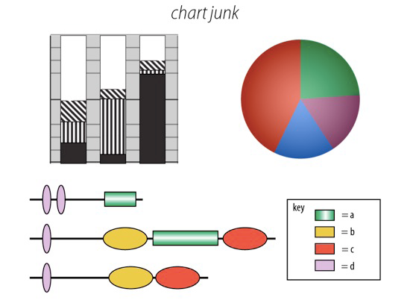
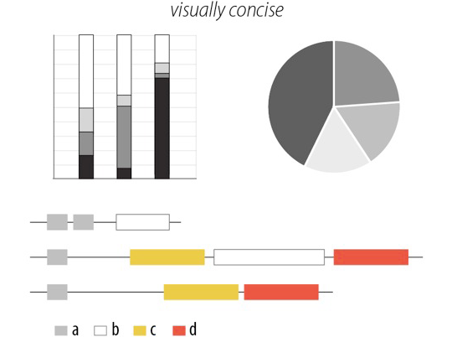
Principle 3: importance ordering
Simplify, simplify, simplify…
Sharov AA, et al (2006) Genome Res 16: 505-509.
Peterson J, et al. (2009) Genome Res 19: 2317-2323.
Thomson NR, et al. (2005) Genome Res 15: 629-640.
DB, Ko MS (2005) Genome Res 15: 748-754.
M. Krzwinski, behind every great visualization is a design
principle, 2012

Slide 18
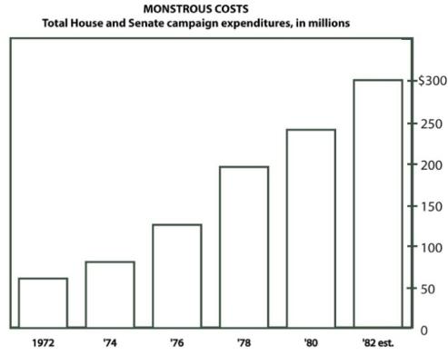
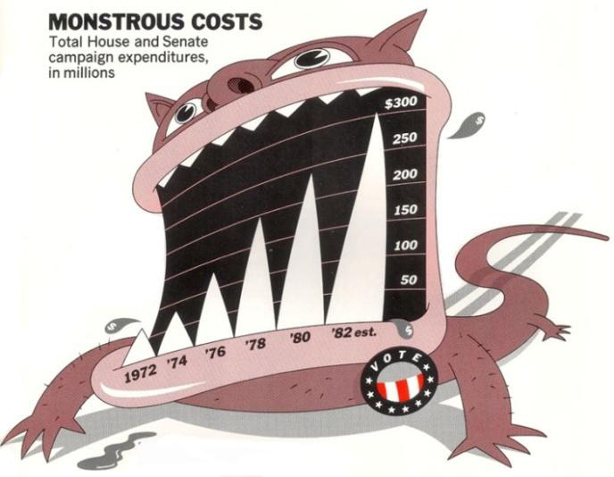
A caveat: “chart junk” and recall
Bateman et al. “Useful Junk? The Effects of Visual Embellishment on Comprehension and Memorability of Charts”, CHI 2010

Slide 19
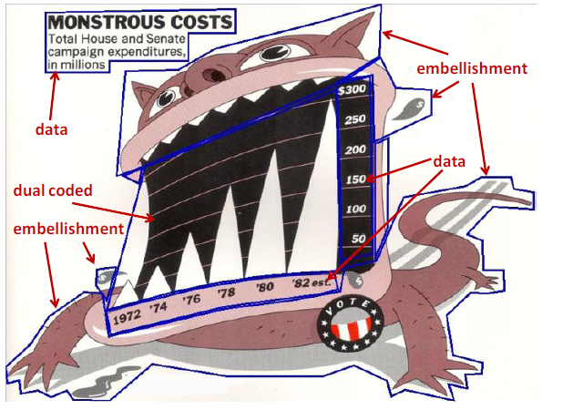
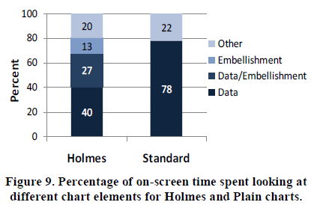
Chart junk and eye gaze

Slide 20
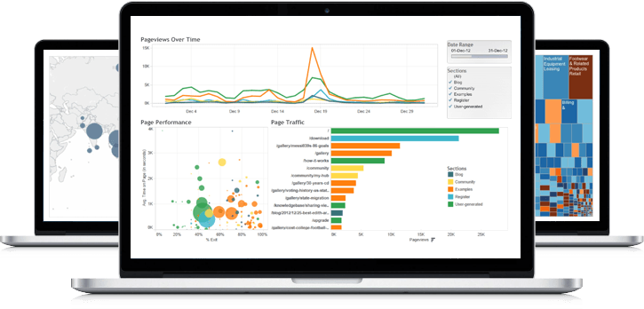
What visualization techniques do you know?

Slide 21
Bar chart
Used for comparable variables
Compares quantitative values for different categories
Highlights relative amounts
Grouped/stacked bars can break each category into sub-groups

Slide 22
Histogram
Looks like a bar chart… but the x-axis is continuous
Y-axis shows count or relative frequency
Highlights distribution
Note: bin size makes a big difference!

Slide 23
Boxplot
Also useful for highlighting distribution
Calls out key values:
median
1st & 3rd quartiles
“fences”
outliers
“fence”
(1.5IQR)
3rd
quartile
outlier
median
1st
quartile

Slide 24
Boxplot add-ons
Use “jitter” to show actual values
Reference lines can help provide context
Can use annotations to show statistical significance

Slide 25
Scatterplot
Shows the relationship between two continuous variables
Each point in the plot represents an observation
You can change color or symbol to highlight groups
Sometimes useful to show a trend line (regression)

Slide 26
Scatterplot matrix (SPLOM)
Scatterplots show the relationship between just two continuous variables at a time
We can combine multiple scatterplots into a matrix to show additional relationships

Slide 27
Line chart
Shows the trend in one variable, often over time
Multiple lines can show multiple variables, or the same variable for multiple observations (must have the same scale!)
Highlights “position switches”

Slide 28
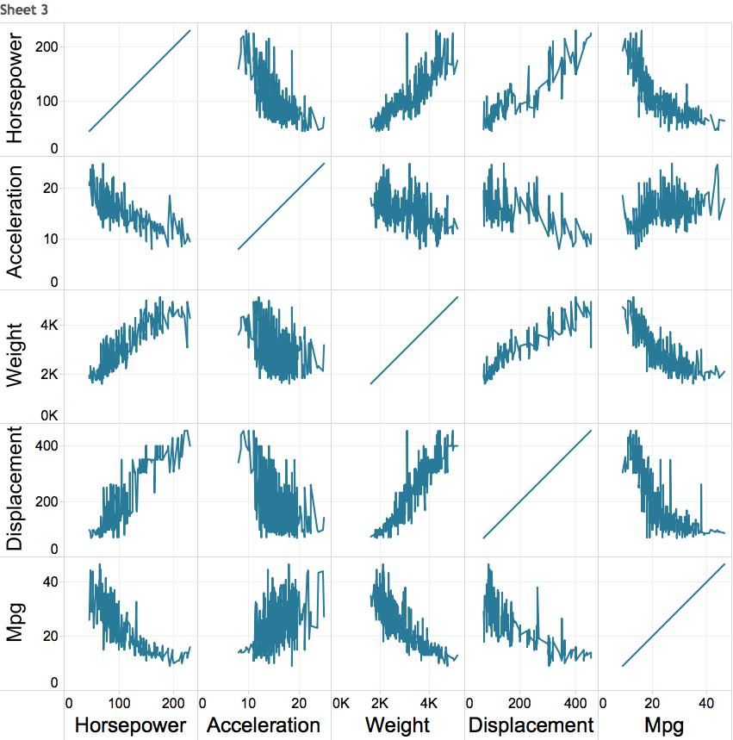
Multiple variables: line chart matrix?

Slide 29
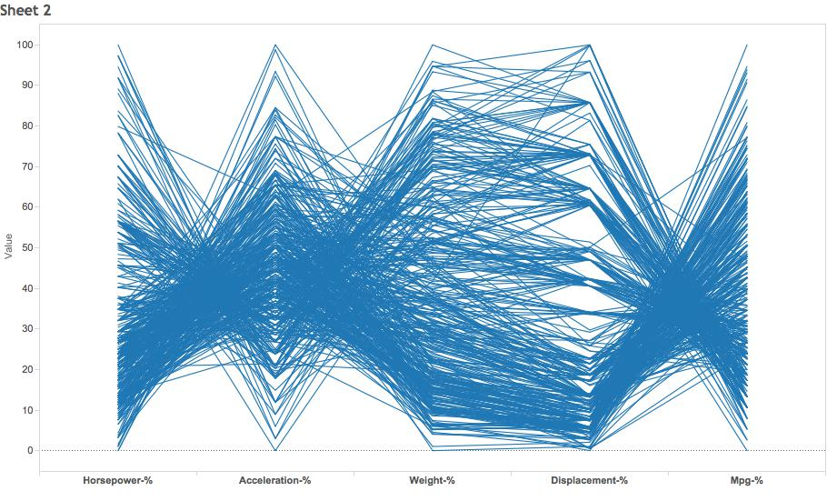
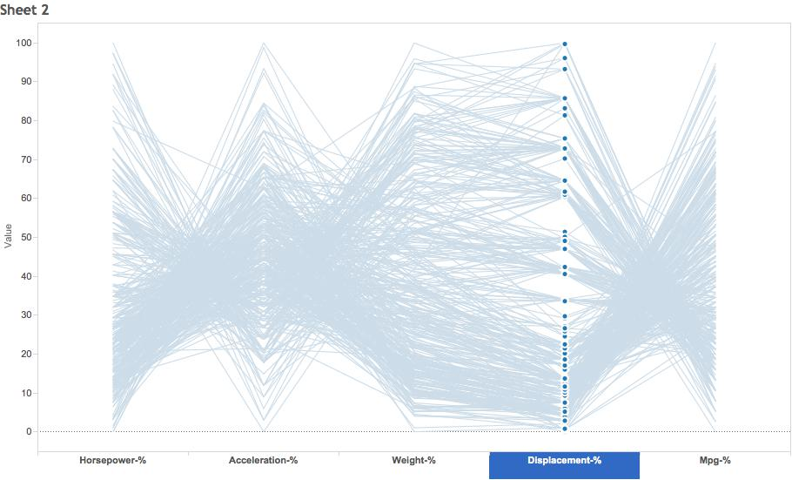
Weirder idea
H A W D M
“parallel coordinates plot”

Slide 30
Morning challenge
H A W D M
“parallel coordinates plot”
How would you build this using ggplot2?

